Slide 1


Building the Real-time Web with ASP.NET Core SignalR
Scott Addie @Scott_Addie

Slide 2


SignalR: The what
Started as pet project in effort to build cloud-based IDE
Rewritten for ASP.NET Core
Real-time web app model
Bi-directional HTTP communication between server & client
SignalR client
SignalR connection
SignalR server (Hub)
.NET, JS, Java, C++
HubConnection
Unofficial:
Swift
WebSockets
Server-sent events
Long polling
Notes:
2011: Work started (Damian Edwards & David Fowler)
2013: Released with ASP.NET
Server-to-client and client-to-server
HubConnection = SignalR’s abstraction of a persistent conn.
WebSockets = 1st choice (persistent, bi-directional conn.)
Best avail. transport selected
Degrades gracefully
Java client added in 2.2
C++ client added in 3.0

Slide 3
Family Guy as it relates to SignalR…

Slide 4
SignalR: The why
Client: “Do you have anything for me yet?”
Server: No.
Client: “Do you have anything for me yet?”
Server: No.
Client: “Do you have anything for me yet?”
Server: Here you go.
GET /server-messages
[“Message 1”, “Message 2”]
GET /server-messages
[]
GET /server-messages
[]
GET /server-messages
[“Message 3”]
GET /server-messages
[]
Notes:
Like kids asking “Are we there yet?”
Reduces chattiness and network congestion
Without WebSockets, there’s no way for a server to send an unsolicited message.

Slide 5


SignalR use cases
Loan decisioning
Appointment scheduling
Virtual whiteboards
Live chat
Stock tickers
Multiplayer gaming
Flight tracking
Voting
Auctions
Social media notifications
Notes:
Apps that require high-frequency updates from server

Slide 6
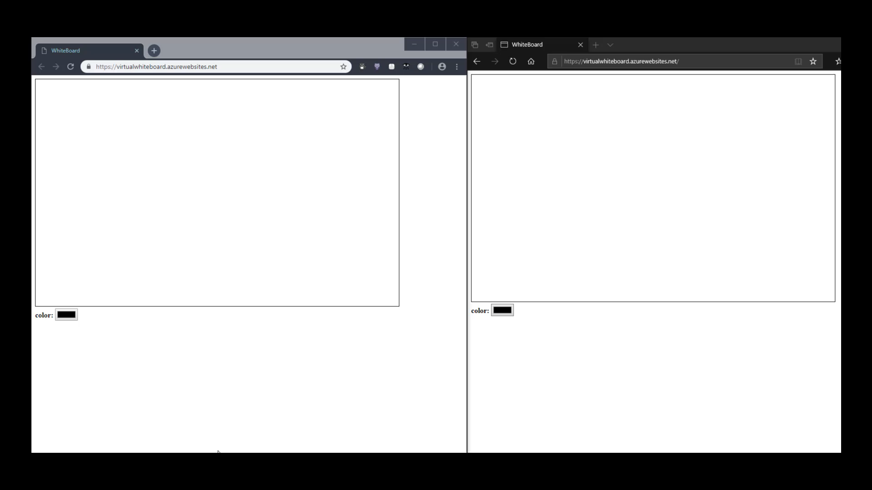
Virtual whiteboard example

Slide 8
Create your first ASP.NET Core SignalR app 5 steps to success

Slide 9

Step 1: Install server bits
Microsoft.AspNetCore.App
Microsoft.AspNetCore
.SignalR
Microsoft.AspNetCore
.SignalR.Common
Microsoft.AspNetCore
.SignalR.Core
Microsoft.AspNetCore
.SignalR.Protocols.Json
Metapackage installs ALL THE THINGS
Notes:
.NET Core 2.1+
.NET Framework 4.6.1+
.NET Framework => Microsoft.AspNetCore.SignalR
Microsoft.AspNetCore.SignalR.Protocols.MessagePack
Binary serialization format, more performant than JSON

Slide 10

Step 2: Startup configuration
Add SignalR services
Add SignalR middleware
Map each Hub to a route
Startup.cs
public void ConfigureServices( IServiceCollection services) { services.AddSignalR(); }
Startup.cs
public void Configure( IApplicationBuilder app) { app.UseSignalR(routes => { routes.MapHub<ChatHub>("/chatHub"); }); }
Notes:
1 hub per feature / endpoint
Makes it clear which conns. associated w/ which hubs

Slide 11
Step 3: Hub creation
C# class deriving from Hub
Client connects to Hub, invokes public methods
Each Hub is a separate “copy” of SignalR
Determine notification granularity:
All
User
Group
AllExcept
etc.
ChatHub.cs
using Microsoft.AspNetCore.SignalR; public class ChatHub : Hub { public void Send(string user, string message) { // Call broadcastMessage to update clients Clients.All.SendAsync("broadcastMessage", user, message); } }
Notes:
- Most critical piece
- Strongly typed Hubs avoid magic strings
- broadcastMessage = method server calls on client
- API in SignalR that allows .NET Core to call JS functions on client
These are server-to-client RPCs (Remote Procedure Calls)

Slide 12
Step 3: Hub creation (strongly typed)
C# class deriving from Hub<T>
C# interface removes magic string
ChatHub.cs
public class ChatHub : Hub<IChatClient> { public void Send(string user, string message) { Clients.All.BroadcastMessage( user, message); } } public interface IChatClient { Task BroadcastMessage( string user, string message); }
Notes:
- Can’t call SendAsync w/ strongly typed Hubs

Slide 13




Step 4: Install client bits
 | Microsoft.AspNetCore.SignalR.Client
 | > npm install @aspnet/signalr
 | UNPKG > libman install @aspnet/signalr -p unpkg -d wwwroot/lib/signalr --files dist/browser/signalr.js --files dist/browser/signalr.min.js
Notes:
Support for LibMan as of VS 2017 15.8
Scoped package name changes to @microsoft/signalr

Slide 14

Step 5: Consumption via client
chat.js
// Create the connection const connection = new signalR.HubConnectionBuilder() .withUrl('/chatHub') .build(); // Create a function the Hub can call to broadcast messages connection.on('broadcastMessage', (name, message) => { // Add the message to the page let listItem = document.createElement('li'); listItem.innerHTML = `<strong>${name}</strong>: ${message}`; document.getElementById('discussion').appendChild(listItem); }); connection.start().catch(err => console.error(err.toString()));
Notes:
JS client:
Create conn.
Create fns.
Start conn.

Slide 15

Client targeting with SignalR Hubs

Slide 16
Clients.All.broadcastMessage()
Client “Andrew”
(Dev)
Client “Damian” (PM)
ChatHub
Client “Glenn” (PM)
Notes:
Notification granularity

Slide 17
Clients.Caller.broadcastMessage()
Client “Andrew”
(Dev)
Client “Damian” (PM)
ChatHub
Client “Glenn” (PM)

Slide 18
Clients.Others.broadcastMessage()
Client “Andrew”
(Dev)
Client “Damian” (PM)
ChatHub
Client “Glenn” (PM)

Slide 19
Clients.Group(“Dev”).broadcastMessage()
Client “Andrew”
(Dev)
Client “Damian” (PM)
ChatHub
Client “Glenn” (PM)

Slide 20
Clients.User(“Glenn”).broadcastMessage()
Client “Andrew”
(Dev)
Client “Damian” (PM)
ChatHub
Client “Glenn” (PM)

Slide 21

Scale-out for your ASP.NET Core SignalR app

Slide 22
Scale-out with SignalR
Necessity with a server farm
Actions on 1 server need to be known to other servers
Handled by backplane
Connected clients
SignalR app instance 1
Redis
SignalR app instance 2
Notes:
- SQL Server not an option, as it was in ASP.NET 4.x
- Redis = backplane
Need to setup your own Redis server/cluster
Sticky sessions required
- When instance 1 wants to broadcast messages to ALL connected clients, it only knows about the clients connected to it.

Slide 23

A weak scale-out solution
Azure App Service
ASP.NET
Core app
Pages
Hubs
Web
traffic
SignalR
traffic
Client
Notes:
All traffic hits the same app
App Service limits the # of concurrent connections (SignalR Service solves this)

Slide 24
A better scale-out solution
Azure App Service Azure SignalR Service
ASP.NET
Core app
Pages
Hubs
Server endpoint
Client endpoint
Web
traffic
SignalR
traffic
Client
Notes:
SignalR traffic offloaded to SignalR Service
Sticky sessions NOT needed
Recommend SignalR Service for PROD workloads
Each time client initiates connection to server, client is redirected to SignalR Service

Slide 25
Azure SignalR Service: Startup configuration
Connection string storage:
Development: Secret Manager
Production: Azure Key Vault
Startup.cs
public void ConfigureServices( IServiceCollection services) { services.AddSignalR() .AddAzureSignalR(); // Longer form below // // services.AddSignalR() // .AddAzureSignalR(Configuration[ // "Azure:SignalR:ConnectionString"]); }
Startup.cs
public void Configure( IApplicationBuilder app) { app.UseAzureSignalR(routes => { routes.MapHub<ChatHub>("/chatHub"); }); }
Notes:
Get SignalR Service conn. string from Keys blade in Azure Portal

Slide 26



Resources @Scott_Addie
Docs
Slides
Sample Apps
➔
docs.microsoft.com/aspnet/core/signalr
➔
docs.microsoft.com/azure/azure-signalr
➔
aka.ms/nop-signalr-slides
➔
github.com/aspnet/SignalR-samples
➔
github.com/scottaddie/VirtualWhiteBoard

